Slide 1
For the Love and Understanding
Teaching Middle School Math with BIG BEAUTIFUL PROBLEMS
Geeks Unite 2.0, Edmonton, 2018
Alicia Burdess, @BurdessAlicia
Grande Prairie and District Catholic Schools

Slide 2
The Painted Cube

Slide 3
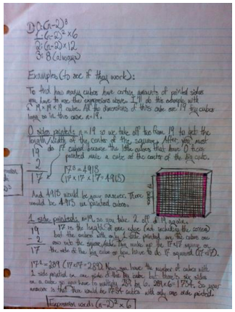
Tell me the story of how you solved the Painted Cube Problem…

Slide 4
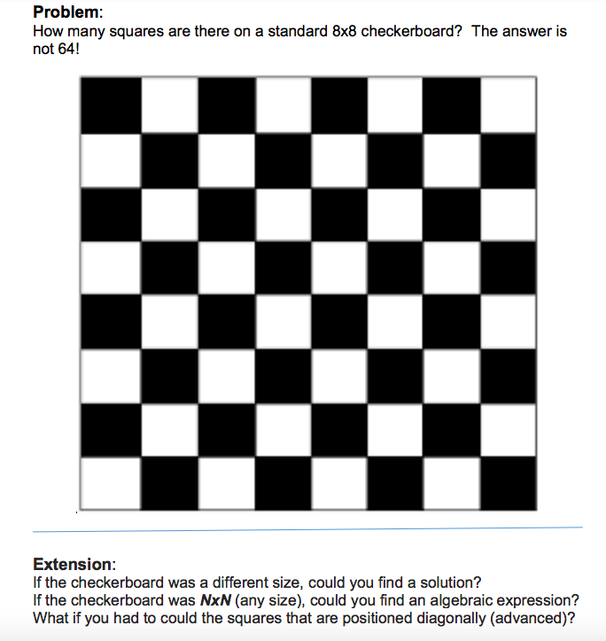
Squares on a Checkerboard

Slide 5
Tell me the story of how you solved the Checker Board Problem…

Slide 6
What did you notice?
about the experience as a learner?
about the experience as a teacher?

Slide 7
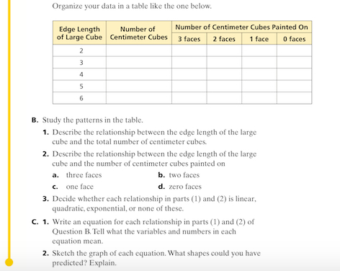
Or we could do it like this?

Slide 8
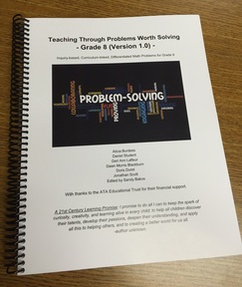
Where do I get more problems?
ATA Library/ www.aliciaburdess.com:
-Grade 8
-Grade 2
-Grade 3 in progress
www.aliciaburdess.com

Slide 9
Die Hard Jugs Problem

