Slide 1
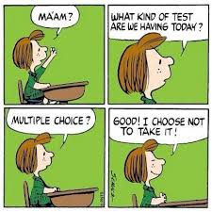
ASSESSMENT – THE FINAL FRONTIER
Friday afternoon MATH fun with Kateri
November 25th, 2016

Slide 2
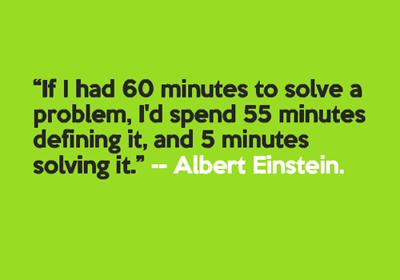
As always, we begin with a problem.
Learning should begin with a question, an idea, something to think about, something to solve.

Slide 3
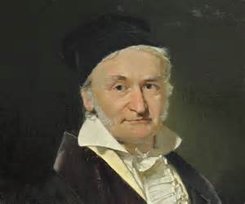
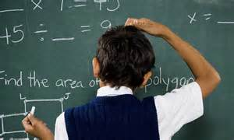
One to One Hundred
Johann Friederich Carl Gauss was a mathematician born in Germany, on April 30, 1777. His parents were poor, and his father expected him to become a bricklayer or a gardener in the family tradition. Were it not for his strong mother and a persistent uncle, Gauss might not have received an education. When Gauss was about 10, his teacher angrily assigned the class of boys a long problem: they should add the first one hundred numbers. Gauss was finished with the problem in a matter of seconds. The teacher was outraged. When the slates were checked, Gauss’s sum was correct.
How did Gauss solve this problem?

Slide 4
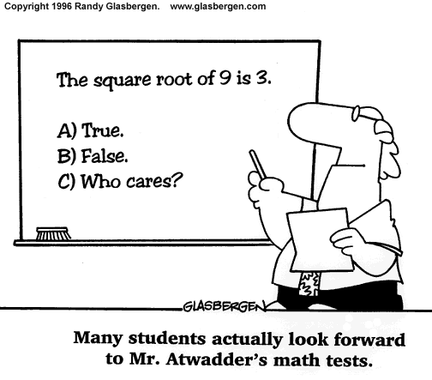
Assessment
Why are we assessing?
What are we trying to assess?
How are we assessing?
*Read The Four Purposes of Assessment by Dr. Peter Liljedahl*

Slide 5
Formative Assessment and Feedback

Slide 6
Examples of Formative Assessment? -discuss at your table-
https://docs.google.com/presentation/d/1nzhdnyMQmio5lNT75ITB45rHyLISHEEHZlHTWJRqLmQ/pub?start=false&loop=false&delayms=3000&slide=id.p

Slide 7
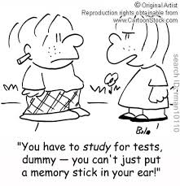
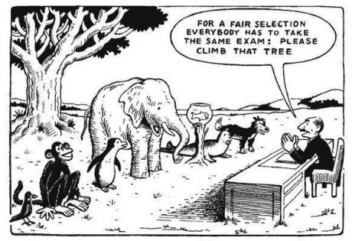
Summative Assessment
Group Discussion

Slide 8
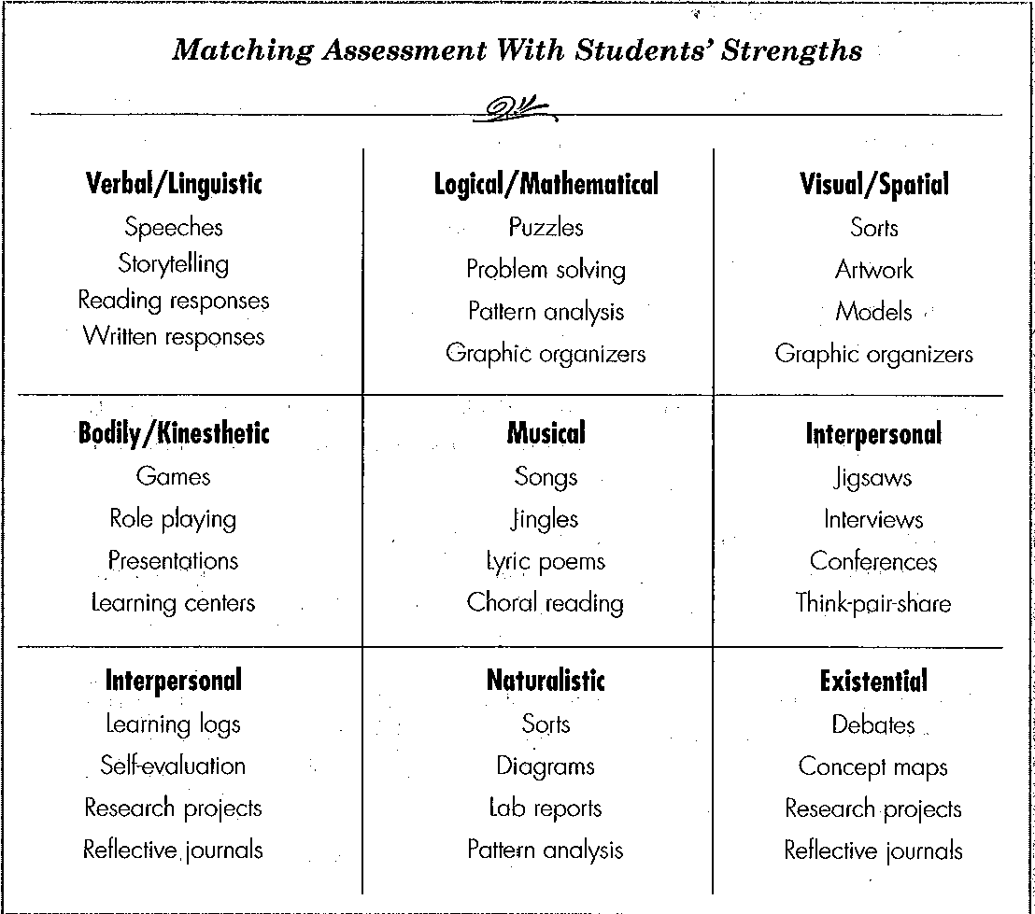
Matching Assessment With Student’s Strengths
Notes:
Important to not permanently categorize a student as having a specific learning style, they can be fluid and change.
We should not teach students in only their preferred learning style or what we are comfortable with.
We should expose students to multiple learning styles and grow their ability to learn in a variety of ways.
Provide options for learning and to help students become aware of what supports their learning at a given time

Slide 9
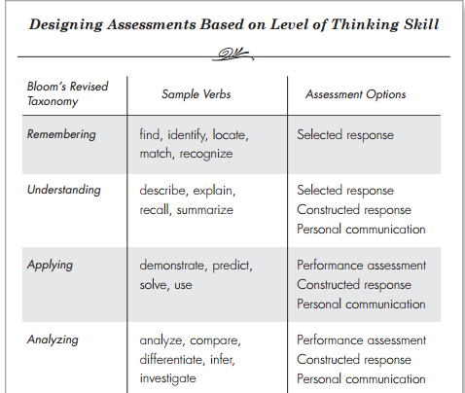
Designing Assessments Based on Level of Thinking Skill
(think Bloom’s Taxonomy)

Slide 10
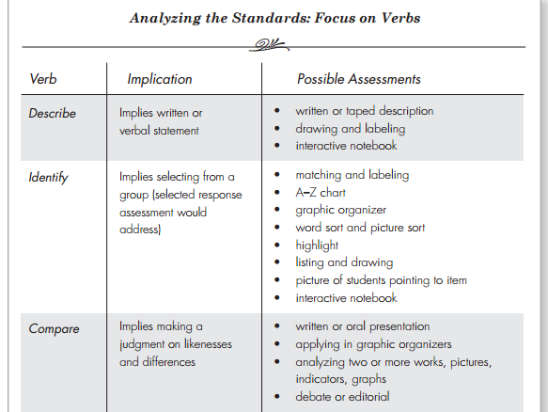
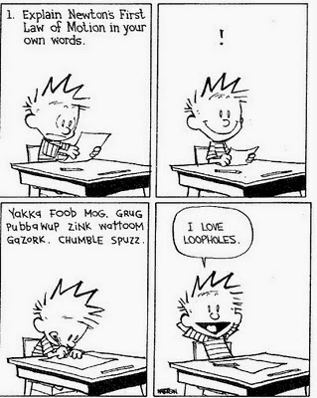
Analyze your outcome – what will you accept as evidence of mastery?

Slide 11
Producibles/Proof/Evidence

Slide 12
Mother-Daughter Tea Party
There is a party for mothers and daughters. All the mothers shake hands among themselves (but not the daughters). Every daughter shakes hands with all the mothers. How many handshakes are there, if it is known that the party involved 17 mother-daughter pairs?

Slide 13
Placemat – individual work in the corners/ group solution in the middle

Slide 14
Burning Questions About Assessment?

Slide 15
I’ll leave you with one last problem…
https://www.youtube.com/watch?v=ADR7dUoVh_c

