Slide 1
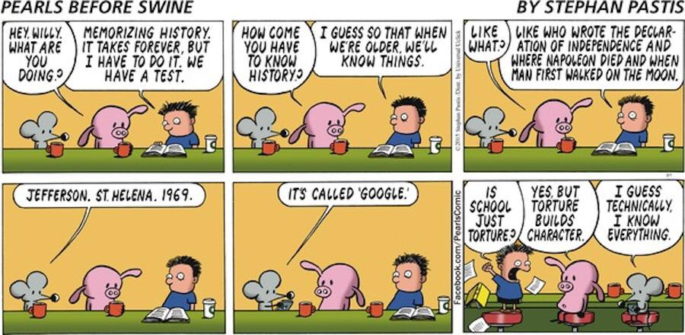
NuMERACY 101 Day 1
GPCSD, January 16, 2018

Slide 2
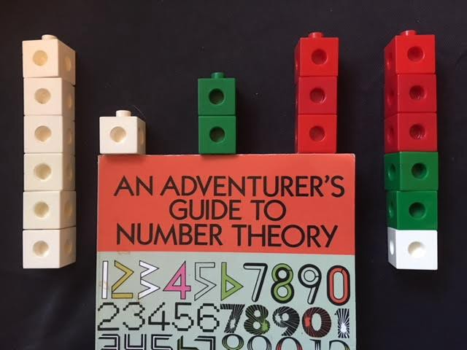
Let’s solve A math probleM!
PERFECT NUMBERS
https://medium.com/q-e-d/the-perfect-math-lesson-what-6-year-old-kids-taught-this-high-school-teacher-9d8e90d31465
Notes:
Random Groups
Vertical Surfaces
One pen

Slide 3
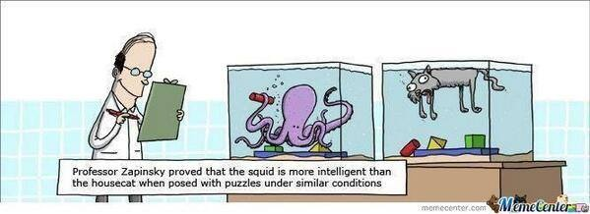
Big ideas/big questions
What does our curriculum say?
What does research say?

Slide 4



FROnt Matter EXPLORATION
WITH YOURSELF
WITH YOUR TABLE
https://youtu.be/OGMJ2b-3eCk

Slide 5
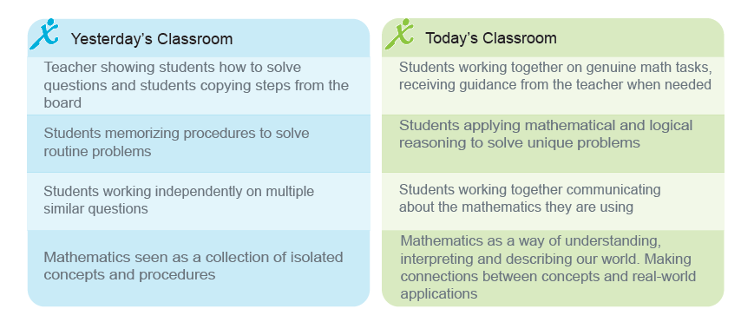
The Math Classroom in 2017

Slide 6
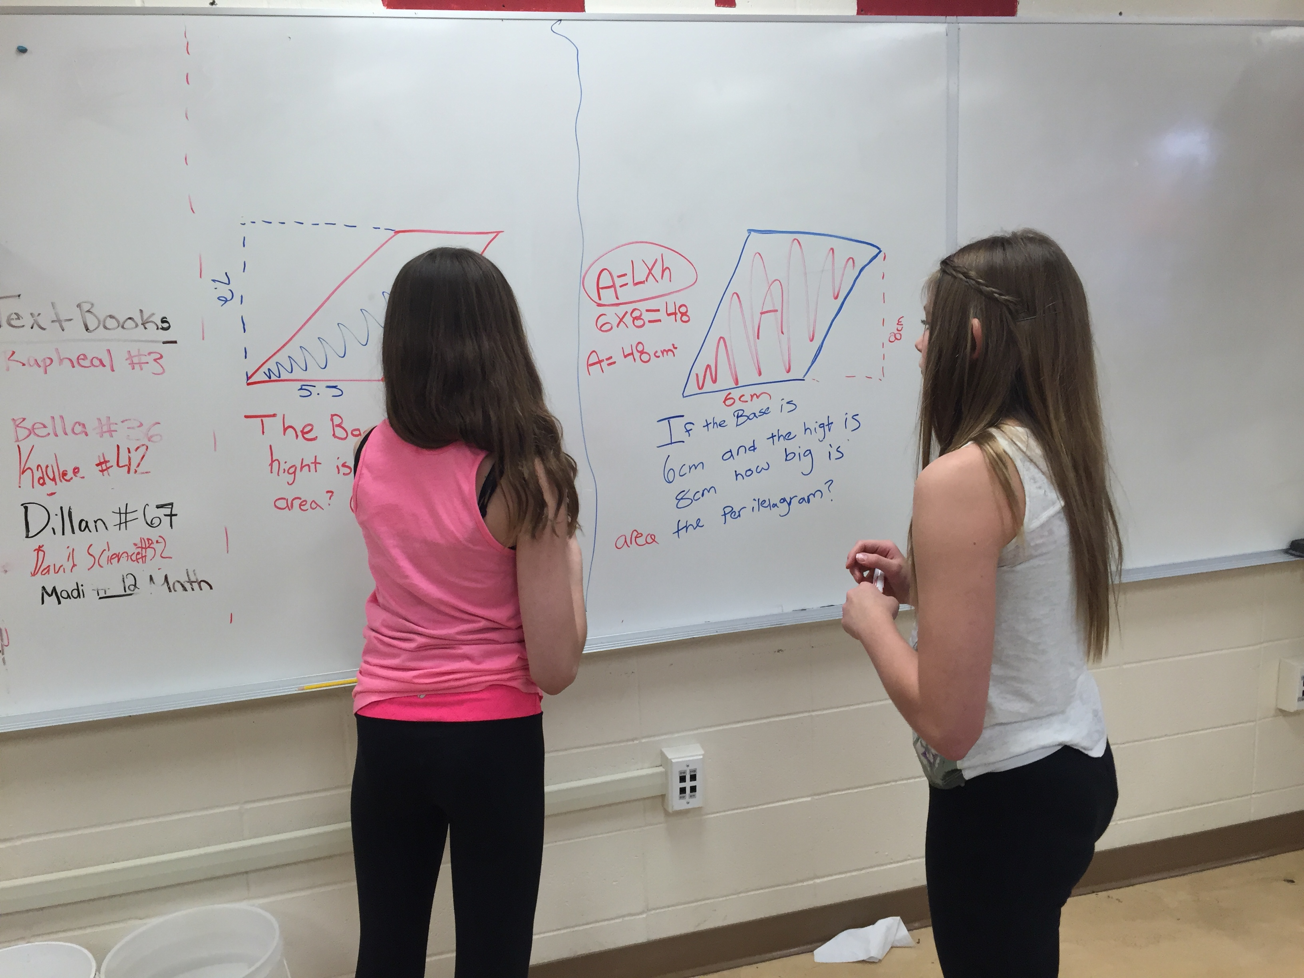
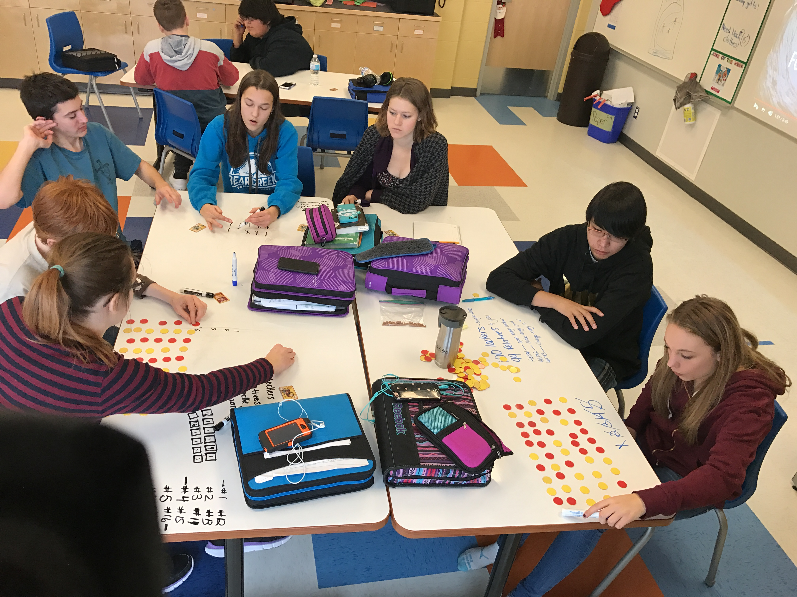
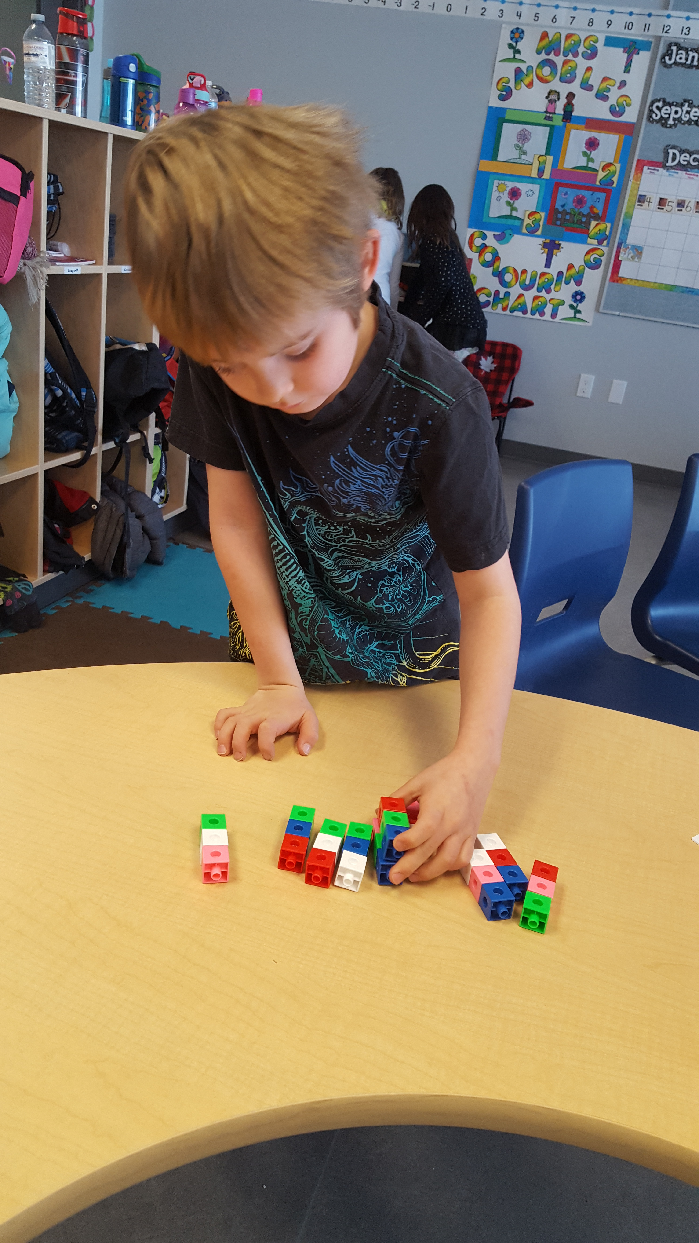
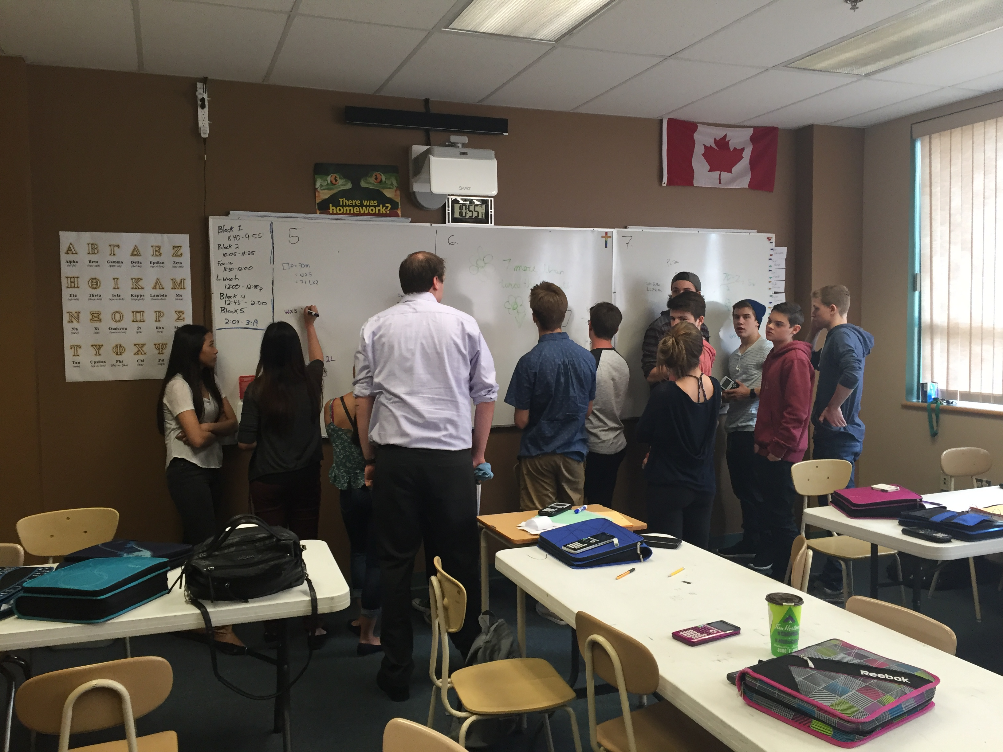
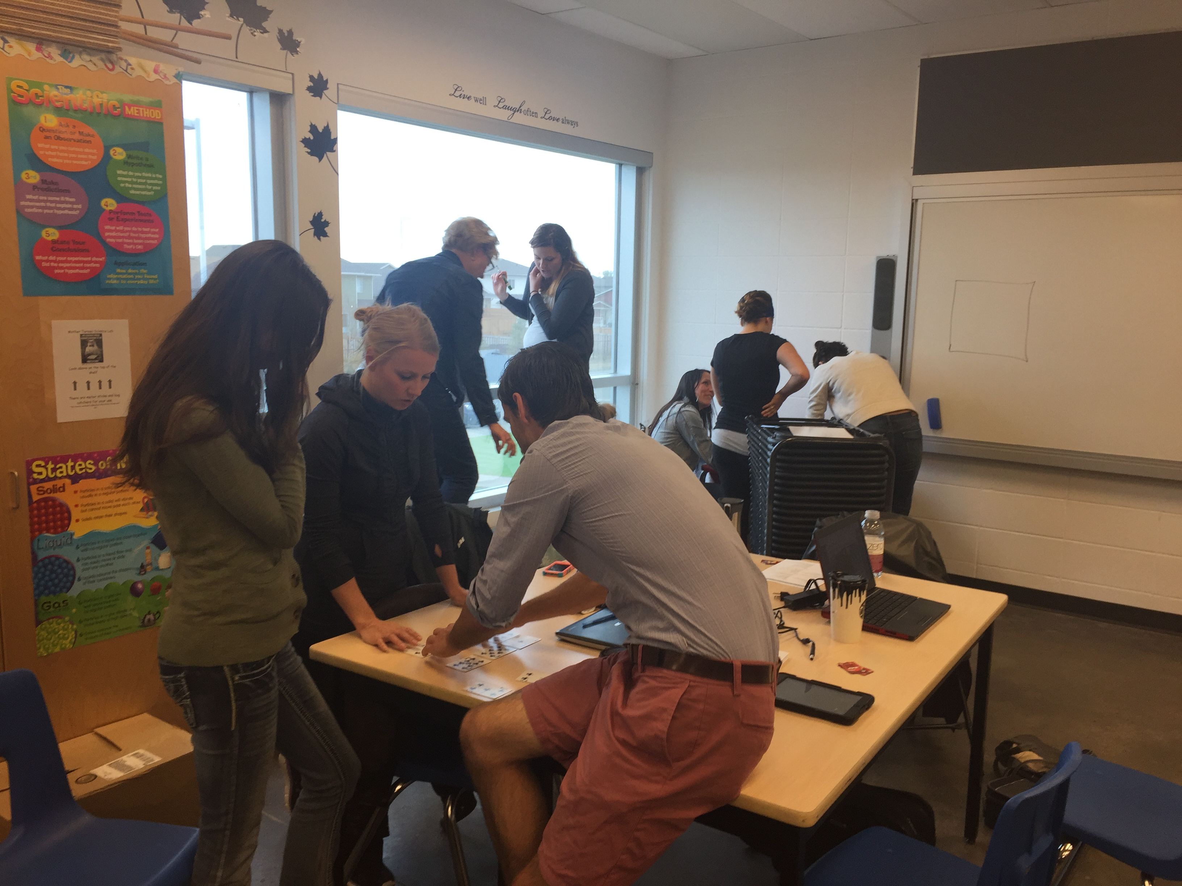
What do you Notice?

Slide 7

What is Number Sense?
How do we develop Number sense?
“Worksheets don’t grow Dendrites” – Marcia Tate
Notes:
What number do we see here? How do we see that number? Can you explain with pictures, with words? What other ways do you see 25?

Slide 8

Dot Collections
Notes:
Subitizing/ Making 10 – “Tenness”

Slide 9

Dot Collections
Notes:
ALICIA

Slide 10

5-frames
Notes:
ALICIA

Slide 11
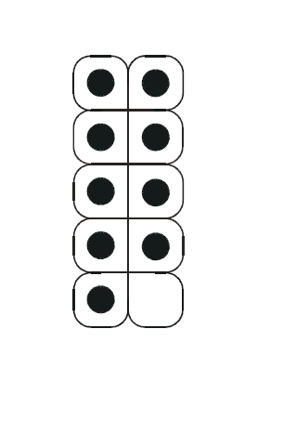
10-frames
Notes:
ALICIA

Slide 12
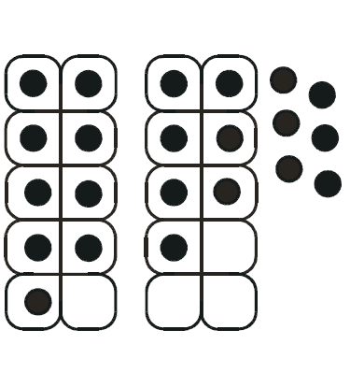
10-frames
Notes:
ALICIA

Slide 13
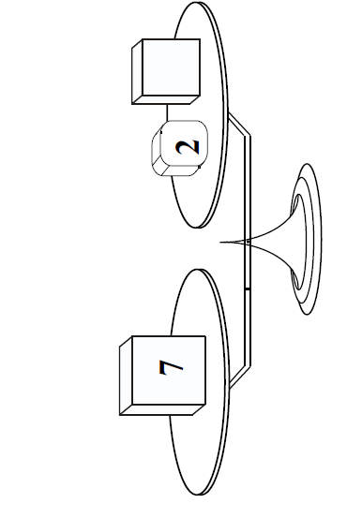
Balances
Notes:
ALICIA

Slide 14
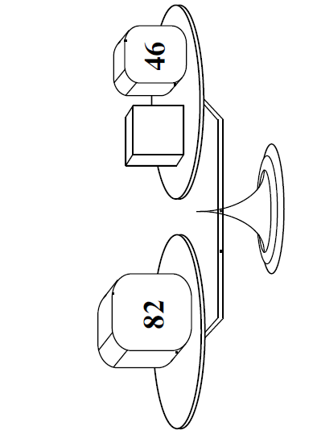
Balances
Notes:
ALICIA

Slide 15
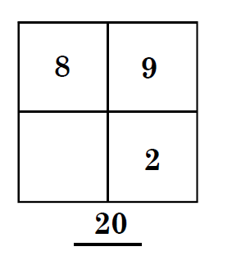
Math Squares
Notes:
ALICIA

Slide 16
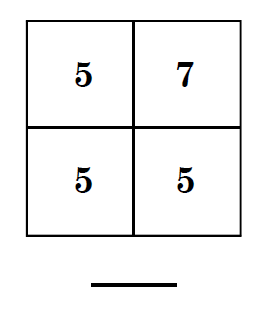
Math Squares
Notes:
ALICIA

Slide 17
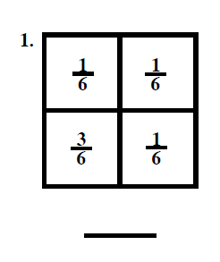
Math Squares
Notes:
JESSIE

Slide 18
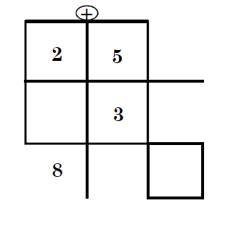
Two Ways
Notes:
ALICIA

Slide 19
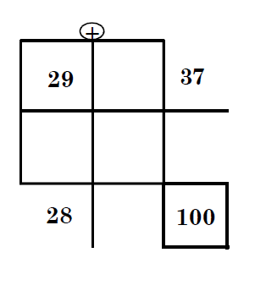
Two Ways
Notes:
ALICIA

Slide 20
Collaboration time
In grade level groups, explore and investigate the COMING TO KNOW NUMBER resource and, with the help of your program of studies, find three problems that link to you curriculum.
Try them out with your students. Use random groups, vertical surfaces, one pen!

Slide 21
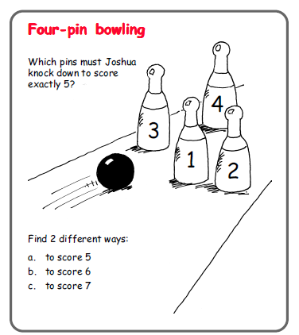
Let’s solve A math problem!
Notes:
Random Groups
Vertical Surfaces
One pen
Low Floor High Ceiling
Puzzles and Problems

Slide 22
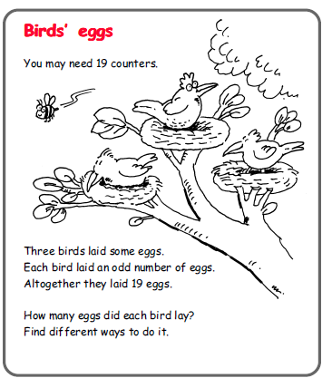
Let’s solve A math problem!
Notes:
What did you notice about the experience?
What did you notice about you as a learner?
What did you notice about the teacher?

Slide 23
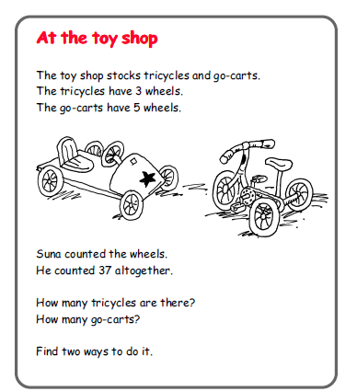
Let’s solve A math problem!
Notes:
Random Groups
Vertical Surfaces
One pen
Low Floor High Ceiling
Puzzles and Problems

Slide 24

SPEED DATING
Notes:
What is your biggest take away from today?
What are you going to do with your students tomorrow?

